Slide 1
County of Sacramento
Voter Registration and Elections
Guide to Voter Registration

Slide 2
This presentation has been prepared as a reference to help individuals, groups and volunteers participating in voter registration activities. It is important that anyone seeking to register individuals to vote know the regulations and laws regarding voter registration.
We encourage citizen involvement in the electoral and registration processes.
Additional information or clarification is available by calling the Voter Registration and Elections Office at (916) 875-6451. Office hours are Monday through Friday, 8:00 a.m. through 5:00 p.m., excluding holidays.

Slide 3
How to Get Started
Visit the Elections Office
7000 65th Street, Suite A, Sacramento, CA 95823
There is no charge for voter registration forms
If an individual or organization wishes to obtain 50 or more voter registration forms, they must complete the Voter Registration Card Statement of Distribution form. This form is provided by the Elections Office and requires the name, address, telephone number and organization of the person requesting the forms as well as a brief explanation of how the forms are to be distributed
If 2,000 or more voter registration forms are requested, a copy of the Voter Registration Card Statement of Distribution form is forwarded to the Secretary of State, Elections Division

Slide 4
Voter Registration Card Statement of Distribution
This form must be filled out by anyone obtaining 50 or more registration forms
Fill out the following information
General Information:
Name
Date
Name of Organization
Street Address, State, Zip Code
Telephone Number
Proposed Method of Distribution:
Choose at least one method of distribution
Provide a brief explanation of the distribution plan
Declaration:
Must be read and acknowledged
PowerPoint Presentation must be dated with the date it was viewed
Signature:
Person obtaining registration forms must sign
Serial Numbers:
Will be filled out by the Elections Office

Slide 5
Important Things to Remember When Distributing Registration Forms
Ask people if they are registered to vote; if not, offer the person a voter registration form
Ask if they know anyone who is not registered to vote; if they do, offer the person a form
Encourage individuals to mail their own forms back; no stamp is necessary, return postage is paid by the Secretary of State
Instruct people to use black or blue ink when completing a form
All Voter Registration forms must be accurate and complete
Make sure people understand that the Voter Registration forms should be completed by the voter unless assistance is necessary
Make a Distribution Plan
No Fees may be charged for registering to vote (Election Code 2121)
Direct any questions regarding voter registration or elections to the
Sacramento County Elections Office
Telephone Number: (916) 875-6451
Email: voterinfo@saccounty.gov

Slide 6
Important Things Not To Do When Distributing Registration Forms
Do not use a pencil
Do not refuse to give a registration form to anyone who asks for one. You must accept a completed form from anyone regardless of their party preference or address. Forms where an individual lists a residential address outside of Sacramento County will be forwarded to the appropriate county.
Do not highlight or make any marks on the registration form
Do not attempt to answer questions, except to explain how to complete the Voter Registration form
Do not give Voter Registration forms to other people or organizations who have not been authorized to distribute forms by the Elections Office (Remember you are solely responsible for the registration forms that are assigned to you)

Slide 7
Who is Eligible to Register to Vote?
Anyone who is:
A citizen of the United States
A resident of California. 16 years old may pre-register, they must be 18 years old on or before Election Day to vote in an Election
Not serving a state or federal prison term for the conviction of a felony
Not deemed by an appropriate court to be mentally incompetent
Elections Codes: 2000, 2101, 2211

Slide 8
When should a person fill out a Voter Registration Form?
If a person meets the eligibility requirements and if they—
Have never registered to vote in Sacramento County
Have moved
Have changed their name
Wish to change their political party preference
Wish to update their signature on their voter registration

Slide 9
Step by Step Instructions on How to Complete a Voter Registration Form
Box 1
Qualifications - Citizenship and Age
The voter must check the correct boxes:
I am a U.S. citizen and resident of CA
I am 18 or older
I am 16 or 17 and want to pre-register
Corrections or alterations are not accepted. A new card must be filled out if an error is made
Election Code 2102 (d) - A person who is at least 16 years of age and meets all other eligibility requirements may pre-register to vote. A properly executed registration shall be effective on the affiant’s 18th birthday

Slide 10
Step by Step Instructions on How to Complete a Voter Registration Form
Box 2
Name
Have the voter clearly print their name

Slide 11
Step by Step Instructions on How to Complete a Voter Registration Form
Box 3
Date of Birth, Identification Requirements, and Place of Birth
Date of birth is required
CA Driver’s License OR
CA Identification Card OR
If the voter does not have either, they may provide the last four digits of their Social Security number
If the voter does not have any of the three ID requirements listed above, the registration form will still be accepted
The U.S. State or foreign country of birth

Slide 12
Step by Step Instructions on How to Complete a Voter Registration Form
Box 4
Home Address
Voter must fill in their complete address and city where he/she resides
A Post Office Box or business address is not accepted as a home address
If the voter does not have a residence address
The voter must give an exact description of where they sleep at night. Include cross streets, street corners and basic directions (N,S,E,W), bridges, routes or other landmarks

Slide 13
Step by Step Instructions on How to Complete a Voter Registration Form
Box 5
Mailing Address
Voter must fill out the mailing address field if they wish to receive their election material at an address other than their home address

Slide 14
Step by Step Instructions on How to Complete a Voter Registration Form
Box 6
Prior Registration
Should be completed if the voter has been previously registered in a different state. If the voter does not remember the complete address, have them write as much information as possible.
Not necessary for voters previously registered in a different California county.

Slide 15
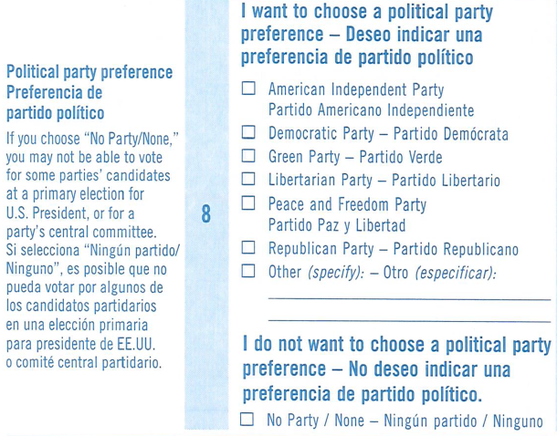
Step by Step Instructions on How to Complete a Voter Registration Form
Box 8
Political Party Preference
The voter may choose to be affiliated with a political party or may choose No Party Preference
If a political party preference is left blank, the voter will be registered as Unknown, and shall otherwise be treated as a No Party Preference voter
Only one political party preference can be marked
Corrections or alterations are not accepted. A new card must be filled out if an error is made

Slide 16
Step by Step Instructions on How to Complete a Voter Registration Form
Box 9 (Optional)
The voter may complete this section if:
They want to provide their email and/or phone number
They want to receive election material in another language
They want to receive election materials in an accessible format
If they’re interested in working in a county Vote Center
They want to provide their ethnicity/race

Slide 17
Step by Step Instructions on How to Complete a Voter Registration Form
Box 10
Signature of Voter
The Registration form must contain the signature of the voter in order to be registered to vote. The signature must match the name written in box 2
The Voter’s Signature, signed under penalty of perjury, is the voter’s confirmation that all the information on the form is true and correct. (Election Codes 2111, 2112)

Slide 18
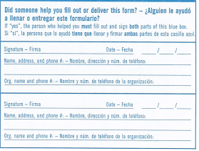
Step by Step Instructions on How to Complete a Voter Registration Form
The Bottom Portion of the Registration Form
If someone helped the voter physically fill out the form, the person who helped must fill out and sign both parts of the box

Slide 19
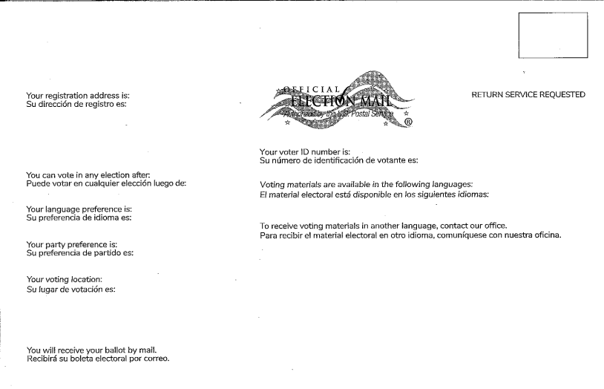
Step by Step Instructions on How to Complete a Voter Registration Form
The Bottom Portion of the Registration Form (Receipt)
At the bottom of the form, fill out and tear off the receipt at the perforation and give it to the voter
The voter will be sent a postcard, like the one below, confirming their registration within 2- 4 weeks. If they don’t receive the postcard, they can contact our office.

Slide 20
Once the Registration Form(s) are Completed
Forms must be delivered to the County Elections Office or the Secretary of State’s Office, or deposited in the postal service within 3 days of receiving the completed forms or by the 15th day prior to an election, whichever comes first
Mailed forms must be postmarked on or before the 15th day prior to an election to be eligible to vote in that election
You are ultimately responsible for the forms that were issued to you

Slide 21
California Election Code
Specific codes covering crimes include -
2159 – Person/Organization who is paid to assist with voter registration must disclose full name, telephone number and address on each affidavit form
2159.5 – Report requirements for person/organizations that pay others for assisting persons to register to vote
18100 – Registration of persons not entitled to register. Consists of nonexistent persons including but not limited to, deceased person, animals and inanimate objects
18101 – Registration of fictitious person
18102 – Registration of nonexistent person
18103 – Interference with transfer of affidavit to county elections official
18104 – Refusal to return affidavits of registration
18105 – Writing or affixing political statements on affidavits of registration
18106 – Alteration of affidavit party affiliation
18107 – Fine for failure to provide voter registration card

Slide 22
Prepared by:
County of Sacramento
Voter Registration and Elections
7000 65th Street, Suite A
Sacramento, CA 95823
Phone: (916) 875-6451
Fax: (916) 875-6516
Email: voterinfo@saccounty.gov
Web Site: www.elections.saccounty.gov
Speech and Hearing Impaired
California Relay Service: Dial 711

